Slide 1
Defender for IoT
100.1 Operational Technology Overview

Slide 2
Agenda
Operational Technology OT Overview
Purdue Model
IT vs OT Security Perspectives
Customer Challenges

Slide 3
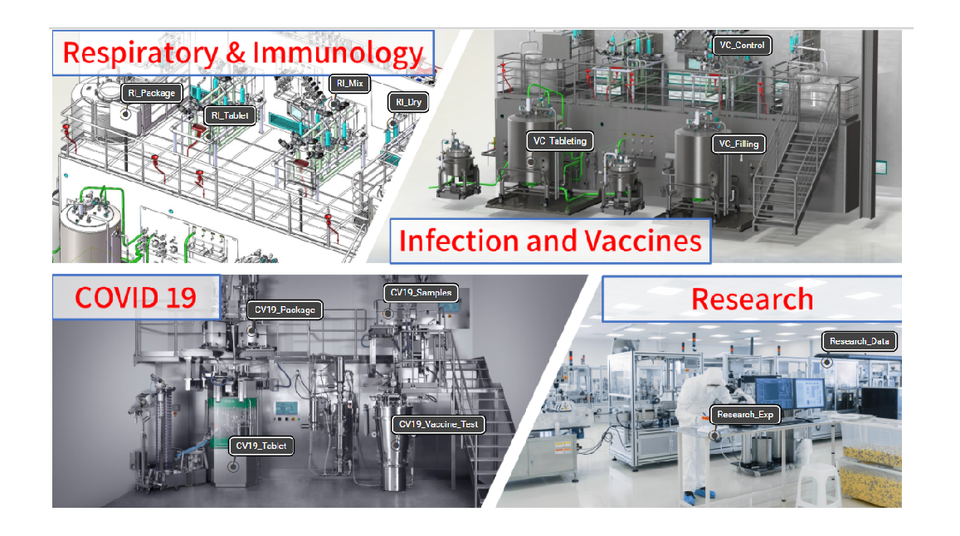
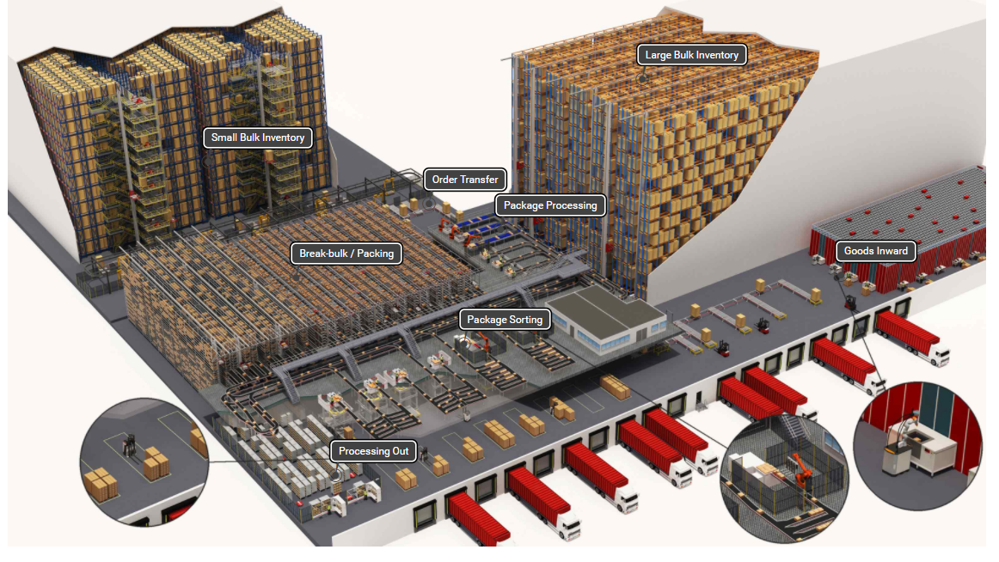
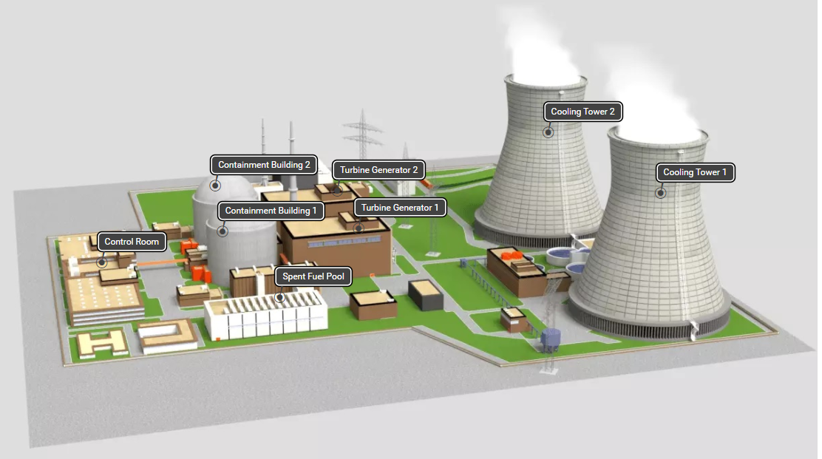
What is Operational Technology?
Pharma
Power Generation
Smart Factories & Distribution Centers

Slide 4
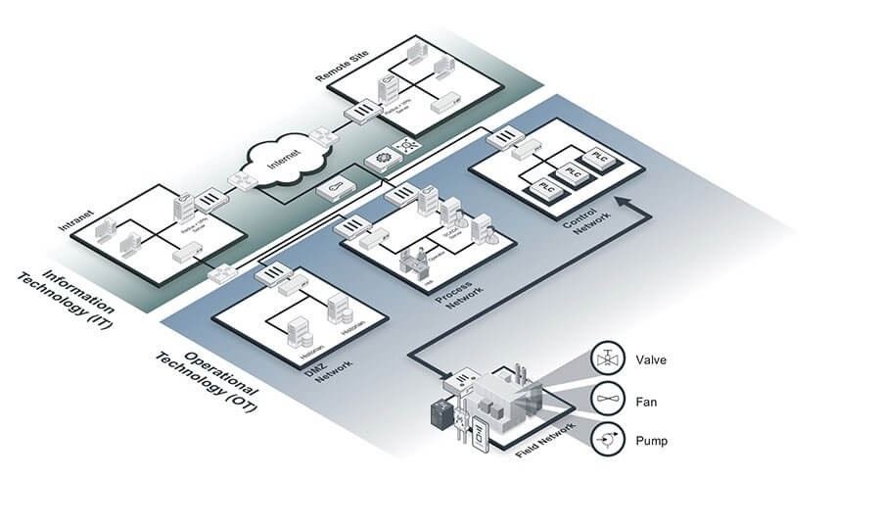
Operational Technology (OT) – the hardware and software dedicated to detecting or causing changes in physical processes through direct monitoring and/or control of physical devices such as valves, pumps, etc.

Slide 5
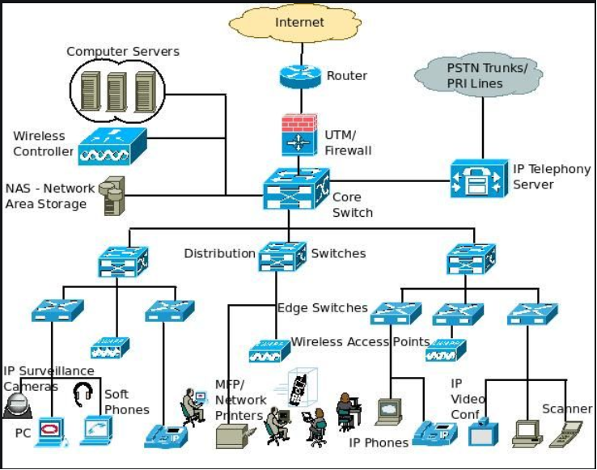
Networking Background
Purdue Model
Enterprise
IT
Level 4 & 5
Industrial DMZ
Level 3 / 3.5
OT
Supervisory
Level 2
Process Control
Level 1
Field control
Level 0
Enterprise Network (IT)
Operational Technology (OT) Network
Industrial Internet Of Things (IIOT)
Industrial Control Systems (ICS) or SCADA

Slide 6
Aligning IT and OT
Purdue Model
Enterprise Network (IT)
Enterprise
IT
Organizational Alignment between IT and OT is critical for Operational success
Different groups need to work together in order to provide successful integration and visibility
Understanding political boundaries are key to success integration
Level 4 & 5
Industrial DMZ
Level 3 / 3.5
OT
Supervisory
Level 2
Process Control
Level 1
Field control
Level 0
Operational Technology (OT) Network
Industrial Internet Of Things (IIOT)
Industrial Control Systems (ICS) or SCADA

Slide 7



Aligning IT and OT
Purdue Model
Enterprise Network (IT)
Enterprise
IT
Organizational Alignment between IT and OT is critical for Operational success
Different groups need to work together in order to provide successful integration and visibility
Understanding political boundaries are key to success integration
Level 4 & 5
Industrial DMZ
Level 3 / 3.5
OT
Supervisory
Level 2
Process Control
Level 1
CIO/COO
Field control
CISO
VP Operations
Line of Business
Level 0
Director
Info Security
General
Manager
Operational Technology (OT) Network
Plant
Engineer
Industrial Internet Of Things (IIOT)
Industrial Control Systems (ICS) or SCADA
Security Mgr/Analyst

Slide 8
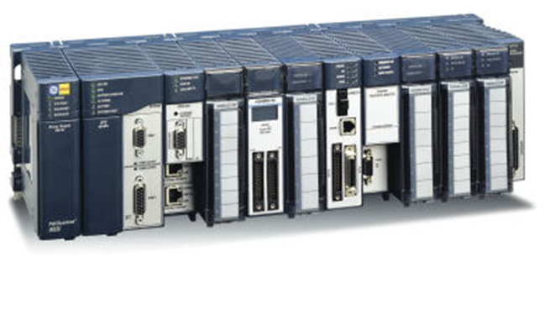
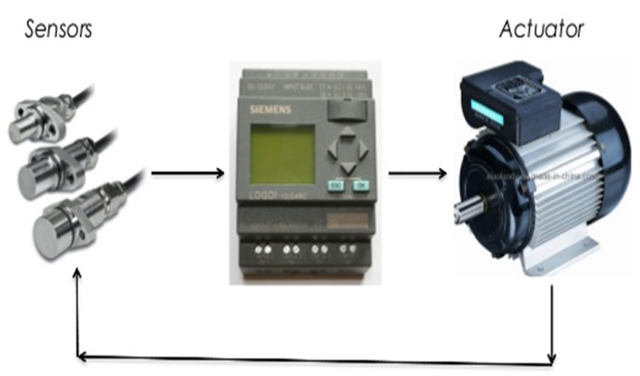
Industrial Control Systems (ICS) Components
PLC – Programmable Logic Controller
PLC receives information from connected sensors or input devices, processes the data, and triggers outputs based on pre-programmed parameters.
ABB, Allen Bradley, Siemens, Mitsubishi, Honeywell, Motorola, Hitachi, General Electric, etc
RTU – Remote Terminal Unit
RTU and PLCs perform similar functions, but used in wider geographical telemetry
ABB, GE Grid Solutions, Honeywell, Schneider Electric, Siemens Energy
 | PLCs | RTUs
How is it configured? | Programmed by plant engineer | Vendor pre-programmed
Power | Moderate to High power consumption | Low power consumption
Network Requirements | Wired – High speed | Wireless, Radio or Satellite - High or Low speed
Environment | Moderate durability | Ruggedized for harsh environments, temperature, etc
Example Application | PLC in manufacturing line for automobile, pharmaceuticals or smart warehouse | RTU on an off-shore oil rig
Reprogramming PLCs quickly allows companies to reset their assembly lines for different products
Preprogrammed interfaces allows easy installation and long-term use of RTUs
PLCs are good for manufacturing environments
RTUs are better suited for remote operations and harsh environmental conditions
Notes:
Top five intelligent RTU market vendors
ABB
ABB provides power and automation technologies for utility, industry, and transport and infrastructure customers worldwide. As of December 2015, the company had 140,400 employees globally and generated total revenues of $35.48 billion.
ABB manufactures and markets a variety of products, including variable speed drives, wind converters, PLCs, motors, generators, robots and robotics, solar inverters, components, and subsystems for railways and related services for a broad range of applications, including process industries, discrete automation, transportation, and utilities.
GE Grid Solutions
GE Grid Solutions is a sub-segment of the energy management segment of General Electric (a diversified infrastructure and financial services corporation). Also, a joint venture of Alstom and GE. GE Grid Solutions provides solutions that modernize grid management and supply power to consumers. It develops, designs, manufactures, and installs a broad range of integrated hardware and software solutions for energy intensive industries, including oil and gas, petrochemicals, utilities, mining, water, heavy industrial, and telecommunications.
Honeywell
Honeywell is a diversified technology and manufacturing company worldwide. The company operates through two business segments: automation and control solutions, and others.
Schneider Electric
Schneider Electric produces a wide range of equipment and components for electricity distribution, energy management, and automation management. Used in a wide range of areas such as computer and peripheral, network and server, data center and facility 3 phase, UPS management, home UPS, UPS replacement batteries, and special applications (includes industrial, telecommunication, and marine). This segment’s key offerings include battery backup, surge protection, power protection, compatibility with three-phase UPS products, monitoring, and control functionality, battery management, and interface cables.
Siemens Energy
Siemens Energy was formerly known as Siemens Power Generation and changed its name to Siemens Energy in October 2008. It operates as a subsidiary of Siemens. The company manufactures fossil fuel power plants and power-generating components, smart meters, gas and steam turbines, wind turbines, generators, renewables, solar power plants, geothermal energy systems, hydro and wind power plants, environmental systems, photovoltaic inverters, fuel gasifier systems, and fuel cells.

Slide 9
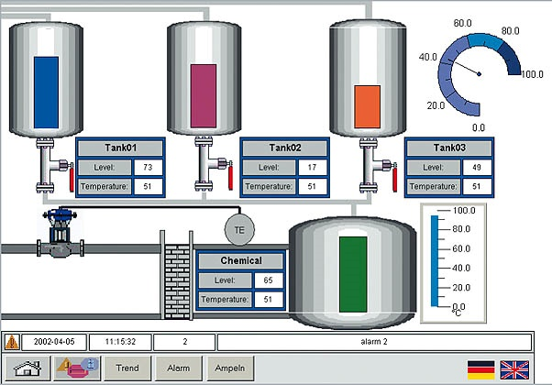
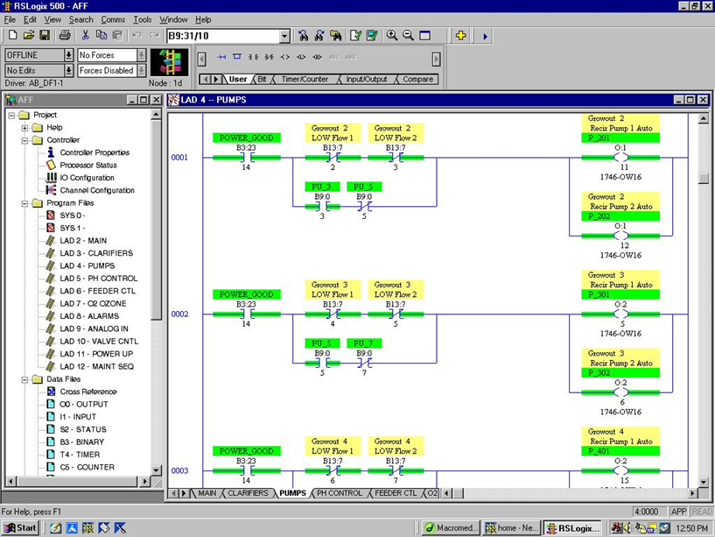
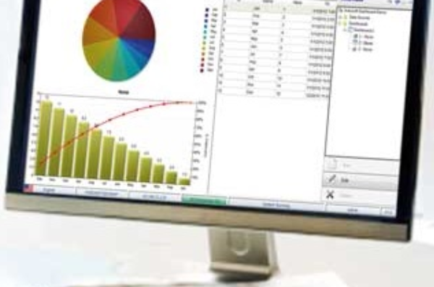
Industrial Control Systems (ICS) Components
PLC – Programmable Logic Controller
PLC receives information from connected sensors or input devices, processes the data, and triggers outputs based on pre-programmed parameters.
ABB, Allen Bradley, Siemens, Mitsubishi, Honeywell, Motorola, Hitachi, General Electric, etc
RTU – Remote Terminal Unit
RTU and PLCs perform similar functions, but used in wider geographical telemetry
ABB, GE Grid Solutions, Honeywell, Schneider Electric, Siemens Energy
HMI – Human Machine Interface
HMI represents plant information to the operating personnel graphically in the form of diagrams
Mitsubishi Electric, Omron, Rockwell, Schneider Electric, etc
EWS – Engineering WorkStation
Very reliable computer designed for configuration, maintenance and diagnostics of the Industrial Control System (ICS) applications
Historian
Architected to pull data from a variety of systems to quickly form a complete context of the manufacturing environment.
Schneider Electric Wonderware, OSISoft PI, Rockwell
Notes:
Top five intelligent RTU market vendors
ABB
ABB provides power and automation technologies for utility, industry, and transport and infrastructure customers worldwide. As of December 2015, the company had 140,400 employees globally and generated total revenues of $35.48 billion.
ABB manufactures and markets a variety of products, including variable speed drives, wind converters, PLCs, motors, generators, robots and robotics, solar inverters, components, and subsystems for railways and related services for a broad range of applications, including process industries, discrete automation, transportation, and utilities.
GE Grid Solutions
GE Grid Solutions is a sub-segment of the energy management segment of General Electric (a diversified infrastructure and financial services corporation). Also, a joint venture of Alstom and GE. GE Grid Solutions provides solutions that modernize grid management and supply power to consumers. It develops, designs, manufactures, and installs a broad range of integrated hardware and software solutions for energy intensive industries, including oil and gas, petrochemicals, utilities, mining, water, heavy industrial, and telecommunications.
Honeywell
Honeywell is a diversified technology and manufacturing company worldwide. The company operates through two business segments: automation and control solutions, and others.
Schneider Electric
Schneider Electric produces a wide range of equipment and components for electricity distribution, energy management, and automation management. Used in a wide range of areas such as computer and peripheral, network and server, data center and facility 3 phase, UPS management, home UPS, UPS replacement batteries, and special applications (includes industrial, telecommunication, and marine). This segment’s key offerings include battery backup, surge protection, power protection, compatibility with three-phase UPS products, monitoring, and control functionality, battery management, and interface cables.
Siemens Energy
Siemens Energy was formerly known as Siemens Power Generation and changed its name to Siemens Energy in October 2008. It operates as a subsidiary of Siemens. The company manufactures fossil fuel power plants and power-generating components, smart meters, gas and steam turbines, wind turbines, generators, renewables, solar power plants, geothermal energy systems, hydro and wind power plants, environmental systems, photovoltaic inverters, fuel gasifier systems, and fuel cells.

Slide 10
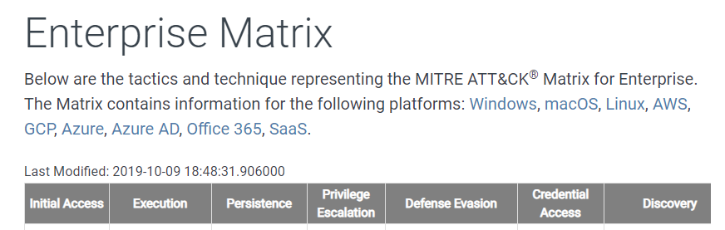
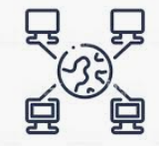
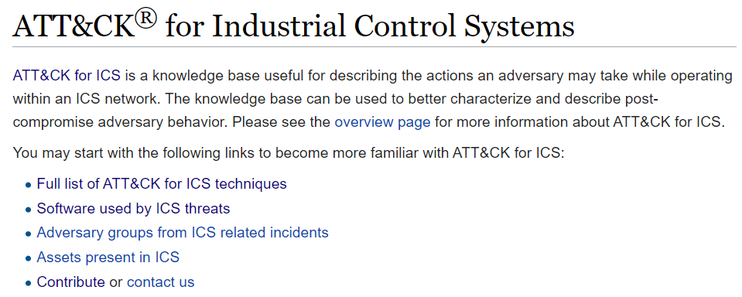
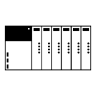



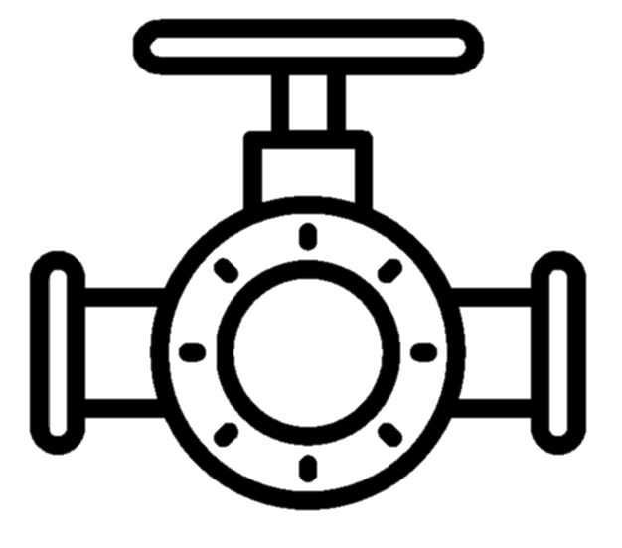
OT Components Within the Purdue Model
Internet
https://attack.mitre.org/matrices/enterprise/
IT
Enterprise
Remote Access
Desktops
Printers
Network Phones
Level 4 & 5
Industrial DMZ
Domain Controller
Level 3 / 3.5
Remote Access
Historian
OT
Supervisory
Engineering
Station
Level 2
Historian
HMI
Process Control
PLC
RTU
Level 1
Field control
https://collaborate.mitre.org/attackics/index.php/Main_Page
Level 0
Sensor
Actuator
Sensor
Actuator

Slide 11

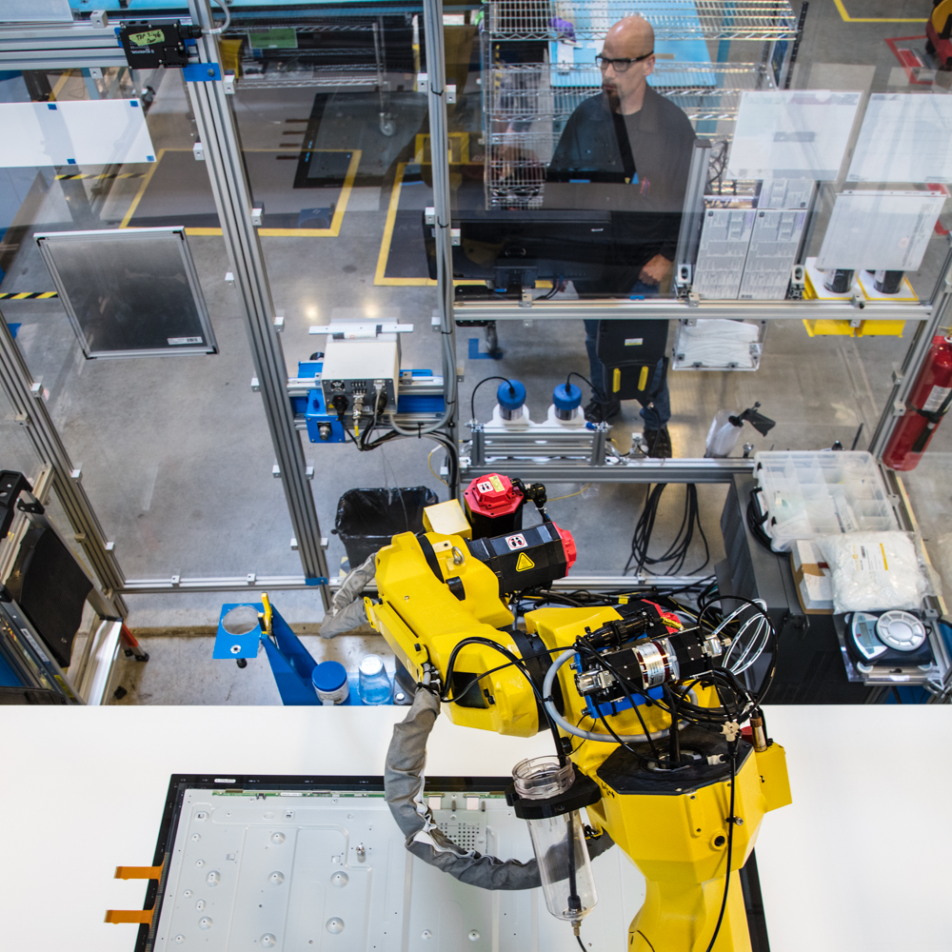
Supervisory Control And Data Acquisition (SCADA)
Ability to Control Ability to Monitor and Collect Information
ICS – Industrial Control Systems
DCS – Distributed Control Systems
PCN – Process Control Network
IT Security
OT Security
Data confidentiality & privacy
Safety & availability
High levels of connectivity
Traditionally air-gapped
Standard protocols & devices
Specialized protocols, devices & legacy OS platforms
Multiple layers of controls & telemetry
Little or no visibility into IoT/OT risk

Slide 12
Supervisory Control And Data Acquisition (SCADA)
Ability to Control Ability to Monitor and Collect Information
Can you please use the correct term, so I know what you are talking about?
ICS – Industrial Control Systems
DCS – Distributed Control Systems
PCN – Process Control Network
I’m glad we are one happy secure IT, OT, ICS company now
IT Security
OT Security
Data confidentiality & privacy
Safety & availability
High levels of connectivity
Traditionally air-gapped
Standard protocols & devices
Specialized protocols, devices & legacy OS platforms
Multiple layers of controls & telemetry
Little or no visibility into IoT/OT risk

Slide 13
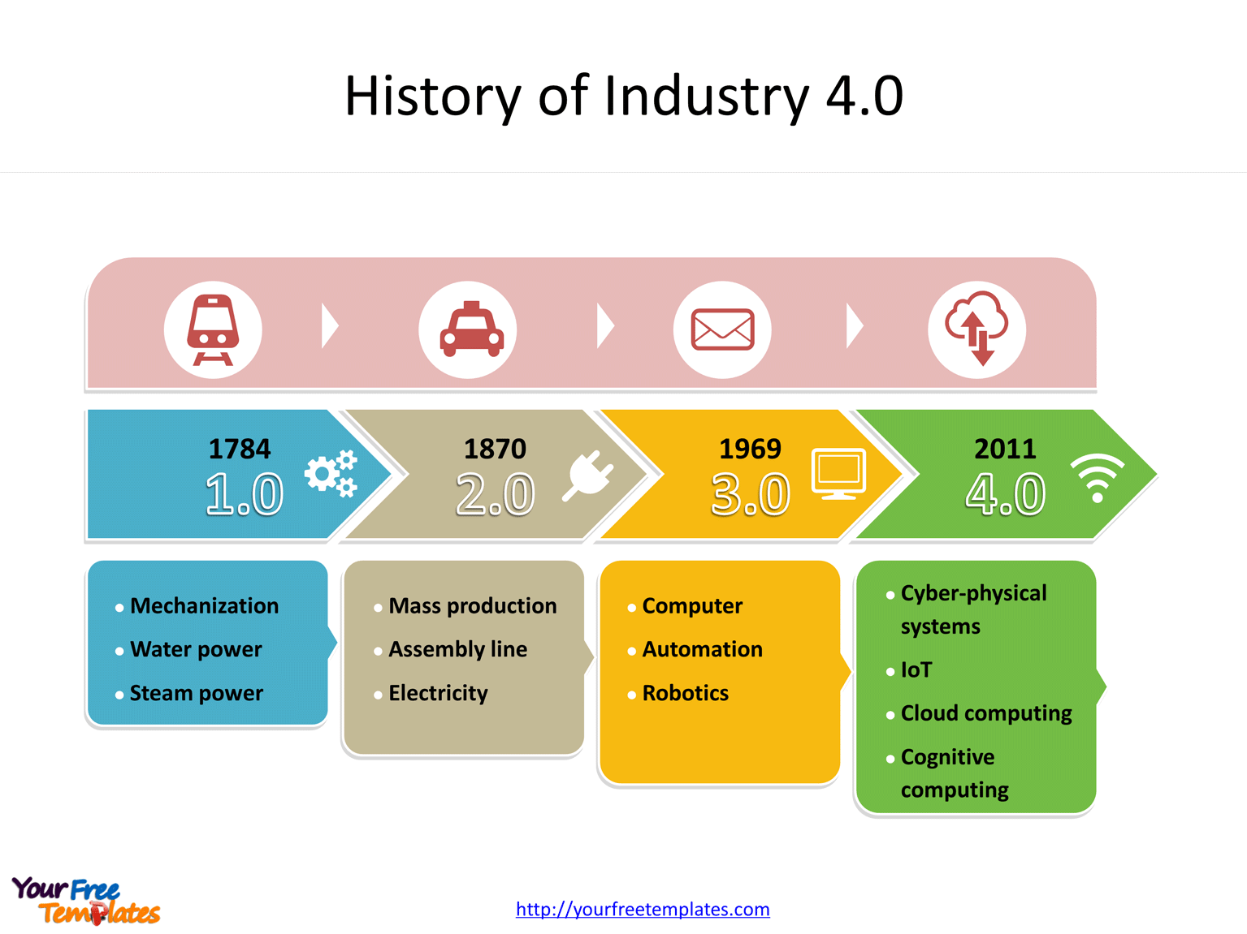
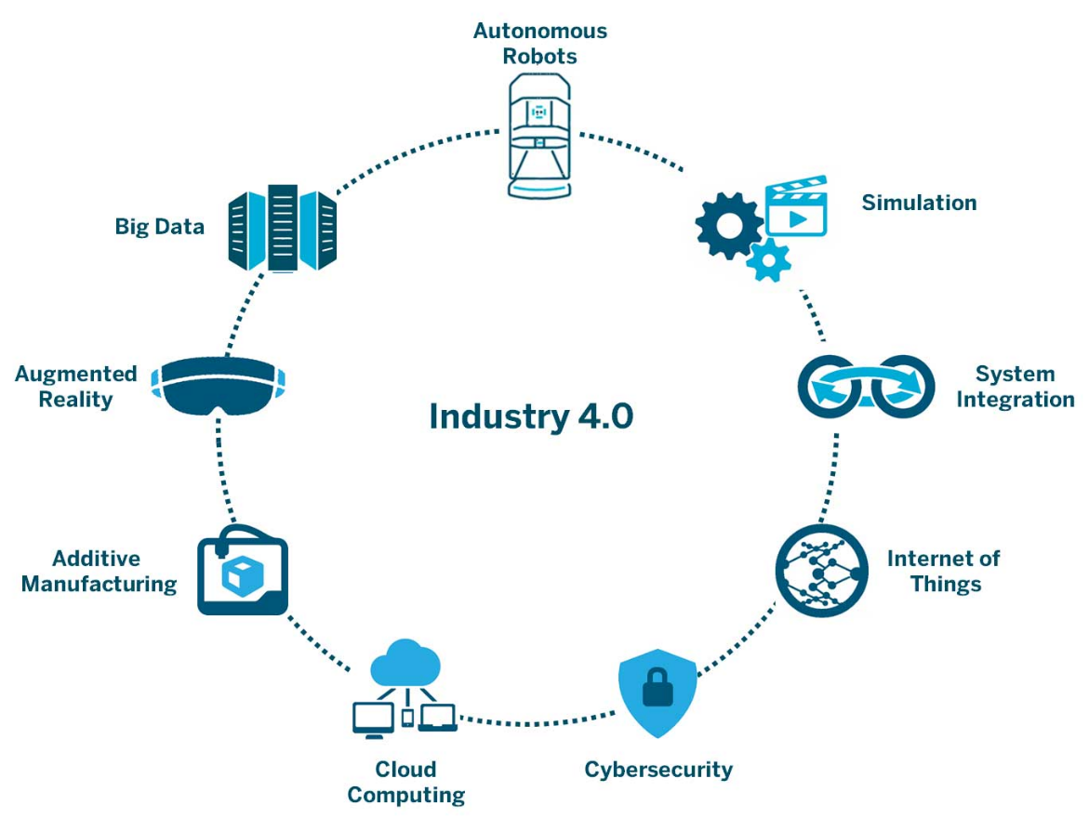
Industry 4.0, Digitalization, Internet of Things (IoT)
Is the trend towards automation and data exchange in manufacturing technologies and processes which include cyber-physical systems (CPS), the internet of things (IoT), industrial internet of things (IIOT), cloud computing, cognitive computing and artificial intelligence.
The rise of Industry 4.0 has introduced a whole new range of security issues now that IT, operational technology (OT) and intellectual property have been integrated.

Slide 14
Longer lifetimes present new challenges
IT Device Lifetime
Hardware lifecycle warranty for 30-50years
IIoT/IoT could have long lifetime
Some machines are 50-100 years old (often with digital retrofit added in last 20-30 years)
OT DEVICE LIFETIME
OT DEVICE LIFETIME
OT DEVICE LIFETIME
IMPORTANT! Many devices are in remote locations hundreds of kilometers away from support technicians
Must support old devices with little/zero security
Must ensure new devices are set up for the long term
Notes:
Is the trend towards automation and data exchange in manufacturing technologies and processes which include cyber-physical systems (CPS), the internet of things (IoT), industrial internet of things (IIOT), cloud computing, cognitive computing and artificial intelligence.
The rise of Industry 4.0 has introduced a whole new range of security issues now that IT, operational technology (OT) and intellectual property have been integrated.

Slide 15



IoT/OT cyber risk = business risk
Safety & environmental incidents
Production downtime
Loss of sensitive intellectual property
Financial losses
Top 6 firms impacted by NotPetya lost $129- $870M
Norsk Hydro lost $71M due to LockerGoga attack
Reduced competitive posture
Manufacturing firms are 8x more likely to be breached for theft of trade secrets than other verticals (2020 DBIR)
Compliance violations, legal liability & brand impact
USCG reports port cargo handling equipment compromised via Ryuk
TRITON attack on safety controllers of petrochemical facility
Confidential
Notes:
https://www.wired.com/story/notpetya-cyberattack-ukraine-russia-code-crashed-the-world/
https://www.cyberscoop.com/cyber-insurance-norsk-hydro-lockergoga-attack/
https://www.zdnet.com/article/us-coast-guard-discloses-ryuk-ransomware-infection-at-maritime-facility/

Slide 16

Challenges Defender for IoT (CyberX) Addresses for Clients
IoT/OT Asset Discovery
Operational Efficiency
What devices do we have & how are they communicating — so we can easily implement better segmentation & zero-trust policies?
How do we identify & rapidly eliminate inefficiencies from misconfigured or compromised networks/equipment?
Risk & Vulnerability Management
Unified IT/OT Security Monitoring & Governance
What are risks to our “crown jewel” IoT/OT assets — and how do we prioritize mitigation?
How do we leverage existing people, training & tools to centralize IT/OT security in our SOCs?
How do we demonstrate to auditors that we have a safety- and security-first environment?
Continuous IoT/OT Threat Monitoring, Incident Response & Threat Intelligence
How do we know if we have any IoT/OT threats in our network right now — and how do we quickly respond to them?

Slide 17
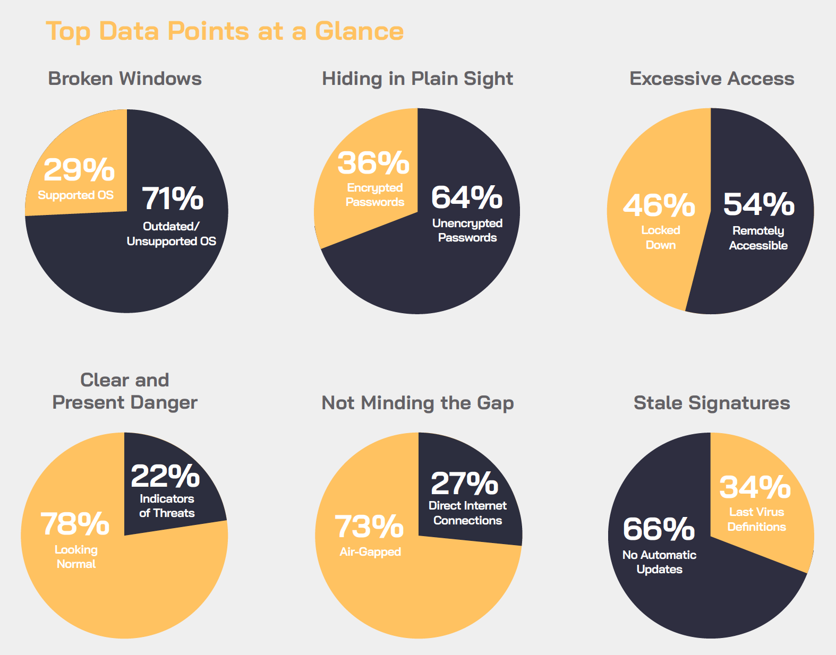
2020 Global IoT/ICS Risk Report A data-driven analysis of vulnerability data collected from 1,800+ production networks
To download the full report, visit cyberX.io/risk-report-2020

Slide 18









Operational Technology (OT) Security Reference Architecture Apply zero trust principles to securing OT and industrial IoT environments
October 2020 – https://aka.ms/MCRA
Business Analytics
Security Analytics
3rd party
Analytics
Azure Analytics
IoT Hub, PowerBI, Azure Edge, Digital Twins, and more
Cloud Environments
Azure Sentinel
Native plug-in for Azure Defender for IoT
Native OT investigation & remediation playbooks
Correlation with other data sources and Strategic Threat intelligence (attack groups & context)
Blended cybersecurity attacks are driving convergence of IT, OT, and IoT security architectures and capabilities
3rd party
Analytics
IIoT / OT Digital Transformation drivers
Business Efficiency - Data to enable business agility
Governance & Regulatory Compliance with safety and other standards
Emerging Security Standards like CMMC
Operational Technology (OT) Environments
Information Technology (IT) Environments
Safety/Integrity/Availability
Hardware Age: 50-100 years (mechanical + electronic overlay)
Warranty length: up to 30-50 years
Protocols: Industry Specific (often bridged to IP networks)
Security Hygiene: Isolation, threat monitoring, managing vendor access risk, (patching rarely)
Confidentiality/Integrity/Availability
Hardware Age: 5-10 years
Warranty length 3-5 years
Protocols: Native IP, HTTP(S), Others
Security Hygiene: Multi-factor authentication (MFA), patching, threat monitoring, antimalware
TLS with mutual authentication
Purdue Model
Safety Systems
Level 3 – Site Operations Control & monitoring for physical site with multiple functions (e.g. plant)
Business Analytic Sensor(s)
Purdue Levels 4 + 5 and Zero Trust
Business Analytics
Level 2 – Supervisory Control Monitoring & Control for discrete business functions (e.g. production line)
NETWORK TAP/SPAN
Sensor(s) + Analytics
Cloud Connection (OPTIONAL)
Plant security console
(optional)
Azure Defender for IoT
Manager
Security Console
3rd party SIEM
Level 1 – Basic Control Electronics controlling or monitoring physical systems
Isolation and Segmentation
Transform with Zero Trust Principles
Purdue model assumed static site/enterprise model
Datacenter Segments – Align network/identity/other controls to business workloads and business risk
End user access - Dynamically grant access based on explicit validation of current user and device risk level
Internal isolation
As business processes allow
Hard Boundary
Physically disconnect from IT network(s)
Soft(ware) Boundary
People, Process, and Tech (network + identity access control, boundary patching and security hygiene)
Level 0 – Process Physical machinery
Zero Trust Principles - Assume breach, verify explicitly, Use least privilege access (identity and network)
Notes:
OT Priorities are mostly focus
(confidentiality assurance are emerging but are generally much lower priority than safety and integrity
ZT Talking Points
Level 4 and 5 assumed datacenter & End User workflows are compatible with IP address/subnet/etc.
Since then we have learned that…
Define ZT Principles
least privilege / assume breach /etc.?
Or Open Group longer list?

Slide 19
Thank You

